Slide 1
Dataset Research

Slide 2
Dataset Research
Data Collection
Business Insights & Understanding
Data Understanding
Model Building & Evaluation
Data Pre-Processing

Slide 3
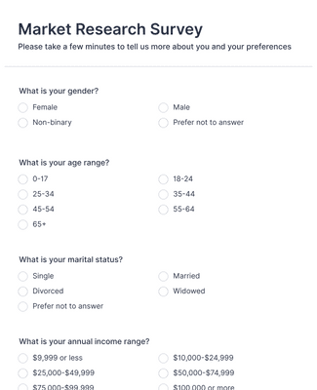
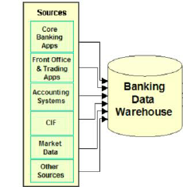
Data Sources
Organization own sources
Market Research conducted by company itself
Data stored through CRM tools in data lake / data warehouse (e.g. Salesforce)
Data stored through employee portals in data lake / data warehouse (e.g. SAP)
Financial analysis and business reports

Slide 4
Data Sources
2. Secondary Sources or Open Sources
Official Government websites and sources
Study reports from research institutes/research firms
Data Scraping from other websites (Social networking, Stocks etc)
Competition websites

Slide 5
Data Sources
Key Considerations in data research
Understand business problem
Prepare lists of analytical approaches (algorithms) to solve your business problems
Explore data sources to pursue machine learning study
Problem Statement: Predict likelihood of a person to response positive on a loan product campaign
Customer demography | family and personal information
Customer Financial assets (with company and outside company) | FD, Mutual funds, stocks , physical assets
Customer Financial Liability (with company and outside company) | Loans, credit cards
Customer Credit score | Cibil score
Customer behaviour towards company campaigns | email activeness, social media presence, other engagement

Slide 6
Process of Data Research
Coordinate with stakeholders to understand data sources
Study available relevant data sources (Data Warehouses / Excel reports) in organization IT infrastructure
Identify relevant data and plan for data collection
Mapping different data sources into Data lake/ Data Warehouse is a critical process
Understanding the ETL/ELT Process required for handling of the data
Business Impact on each of the data source towards the Client Specific needs
Data Integrity & Confidentiality consideration ( Data Leakage has severe impact on Brands)

Slide 7
Alternative solutions for Data
Purchase ready to use AI products e.g. grammarly for content management, ‘trend spider’ for smart trading.
Hire an external AI solution provider to outsource end to end ML study.
Purchase cloud powered AI paid-API solutions (containing pre-trained models) such as azure cognitive services for text analytics, speech recognition.
Create your own data/label
All the solutions described above have cons:
Costly
Training might be required to educate employees
Creates huge dependency on others
Time consuming e.g. evaluation of best products/ service provider
Generating data might create bias and unreliable conclusions

Slide 8
Key Solutions for data research
Kaggle (www.kaggle.com)
These datasets are uploaded for data science problems. Along with raw data sets their description is also available (e.g. link)
Google Dataset Search
Google product to search data sets. It provides lists of sources containing structured as well as unstructured data sets.
UC Irvine Machine Learning Repository
Currently it maintains 588 data sets as a service to the machine learning community
Web scraping
Using python modules
Paid web-scraping tools e.g. Octoparse, ParseHub, Dexi.io

Slide 9
General approaches for data use in data science
Direct import into tool from data source
Data connection to warehouse / data lake (python to azure data warehouse)
Structured csv data on website (e.g. pd.read_csv(url))
API connection (e.g. stock data using paid python APIs)
Scraping unstructured data ( social networking data using python )
Manual import in tool
Dataset collected in excel / csv / text / images / audio files
Reading PDF manuals and reports

